Slide 1
LatentView Analytics
Driving business impact through AI and ML
27 July 2018

Slide 2
Agenda
1
An Introduction to LatentView
2
LatentView Capabilities & Case Studies

Slide 3


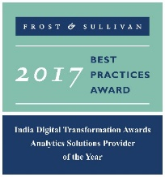




LatentView Analytics at a glance
Awards & Recognition
Founded in
Over
Grown
Work with
Strong Performer - Customer Analytics Services, 2017
550
11
30+
2006
People strong
times in last
six years
Fortune 500
firms
Member of
2009-2017
Technology council
Frost & Sullivan
Analytics Solutions Provider 2017
Only company recognized
Repeat
Business at
4/5
9
top technology companies work with us
>85%
#1
consecutive times in Deloitte Technology Fast50
Analytics Company of the Year 2015

Slide 4


Trusted analytics partner to the world’s most recognized brands
The LatentView Approach
We empower customers in their transformation journey by helping them move up the analytics maturity curve through actionable insights that leads to data-driven decisions that achieve business goals.

Slide 5
Enabling the data driven decision making journey by…
…getting the data together
…making sense of the data
...applying AI & ML to drive impact
Data Acquisition
Acquiring & consolidating the disparate data sources.
Data Engineering
Integrating various forms of data into centralized data lake using on-premise & cloud based technologies
Data Processing
Process various forms of disparate data – Structured, Unstructured, Physical, Human Interactions, Machine Generated, Real Time etc
Graph Analysis
Exploration of frequency, strength and direction of relationships & Causalities.
Exploratory Analysis
Deep insights from all forms of data using traditional methods (Segmentation & Clustering)
Natural Language Processing
Analyze dimensional insights & relationships by automated tagging
Real Time Analytics
Experience in sub-second big data processing for real time applications
Deep Learning & AI
Self governing systems leveraging AI & eliminating manual intervention
Machine Learning
Deep experience with various machine learning algorithms, including Ensemble Learning, Neural Networks, etc.

Slide 6










1. Getting the data together
Data Acquisition
Creating unified data view
Enable Consumption
Structured Data
External / Internal
Customer Data
Web Data
Data Integration
METRIC & EXCEPTION
REPORTS
Marketing Data
Structured
Payment Data
Data store pipelines enables metric & exception reporting
App Data
INTERACTIVE VISUALIZATON
Data Lake
Dispute Information
API endpoints enabling integration with
other systems
BUILD OPERATIONAL EFFICIENCIES
Unstructured Data
External / Internal
Voice Data
Unstructured
ML / AI Workbench for
Prediction & Insights
Chat Data
ADVANCED
ANALYTICS FOR DECISION MAKING
Email Data
Biometric Data
Social Data
Other data sources

Slide 7

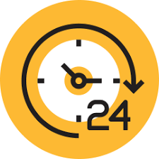






2. Making sense of the data
Reporting & Visualization
Performance Management, KPI Measurements
Monitoring & Control
Real Time Assurance, Audit & Compliance
Voice of Customer
Criticalities, Competitive Intelligence
Segmentation & Clustering
Personalization, Appropriateness etc.
Predictive Science
Demand Prediction, Optimization &
Prognosis analyses
Digital Analytics
Consumer Journeys, Marketing Effectiveness
Experimentation
Experimentation at scale, A/B testing etc.
Integrated & Disparate sources in Data Lake

Slide 8

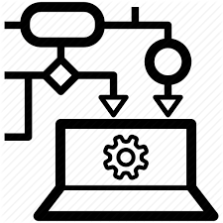
3. AI / ML to drive business impact
Business Planning
Demand Prediction
Market Strategy
Strategic Investments
Early Warning Alerts
Customer Complaints
Transactional Risks
Loss Prevention
Innovation / Insights
Voice of Consumer
Competitive Intelligence
Product Governance
Customer Engagement
Personalization
Acquisition & Conversion
Customer Experiences
Self Serve Analytics through Micro Applications
Complex Data Linearly Scalable With Data Volume
Faster Time To Market Due To Less Set Up Time
Artificial Intelligence / Machine Learning
Integrated & Disparate sources in Data Lake

Slide 9
Latentview Supply Chain Analytics
Jun 20 ,2018

Slide 10
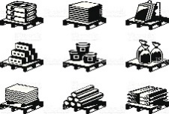




Understanding Supply Chain and the role of Analytics
Plan
Source
Make
Deliver
Supplier
Manufacturer
Warehouse
Retailer
Customer
Key Objective and Levers
Key Drivers
Efficiency
Responsiveness
Facilities
How do we make appropriate role , size and location facility decisions?
Risk
Availability
Cost
Inventory
What should be the optimum level of inventory in the network?
Transportation
How do we make optimal mode of transport capacity decisions?
Pricing
How can we optimize pricing decisions to match demand and supply?
Information
How can we improve the visibility across the supply chain network?
Sourcing
What is the optimal sourcing decision for a desired business objective?
Notes:
Source->Make->Deliver->Plan-→returns.

Slide 11
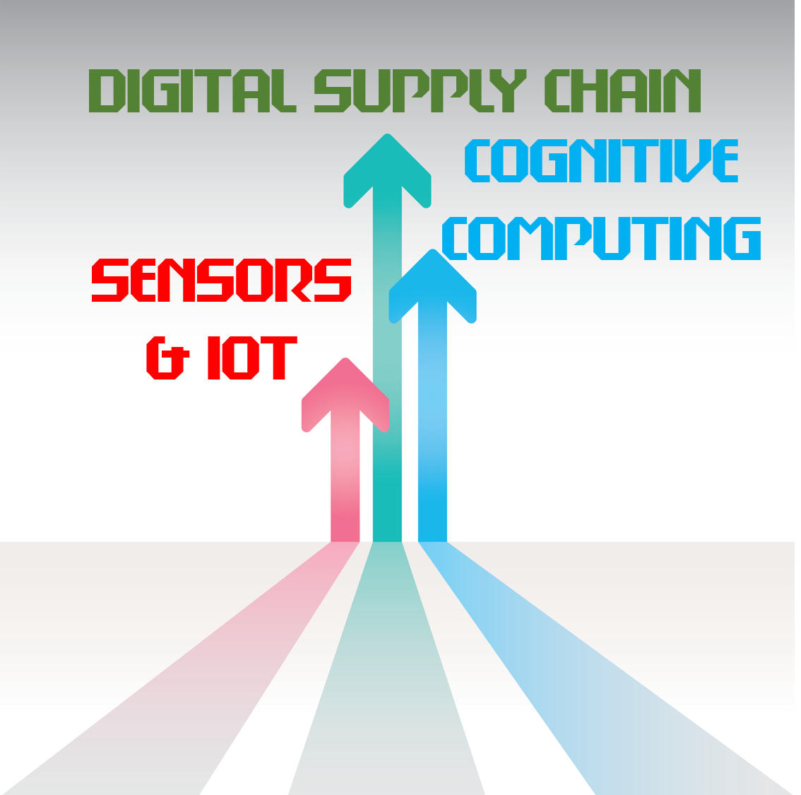
Increasing Complexity and Digitization drives the increasing need for Analytics
Complexity
Digitization
Customers, demand centers sinks
Field
Warehouses:
Stocking points
Sources:
Plants vendors
ports
Regional
Warehouses:
stocking points
Supply
Inventory &
warehousing
costs
Production/
purchase
costs
Transportation
costs
Transportation
costs
Inventory &
warehousing
costs
Notes:
Source->Make->Deliver->Plan-→returns.

Slide 12
Analytics can help to address key challenges with emerging digital opportunities
Improving the Prediction accuracy
How can digital and unstructured data be leveraged support the traditional approach improve the forecast accuracy?
Building a resilient supply chain
How do we proactively identify the risks on the supply chain network and asses its impact to enable effective management decision making?
Improving the velocity or reduce bottlenecks
How can we improve the efficiencies in the supply chain using real time data through emerging Internet of Things (IoT)?
Notes:
Source->Make->Deliver->Plan-→returns.

Slide 13
Supply Chain Analytics Maturity Assessment
Descriptive Analytics
What happened?
Diagnostic Analytics
Why did it happen?
Predictive Analytics
What will happen?
Prescriptive Analytics
How can we make it happen?
Value
Foresight
Network Velocity
Manufacturing Utilization
Supplier Scorecard
Inventory Visibility
Insight
Multi-Echelon Inventory Optimization
What-If Risk Modelling
Route Optimization
Demand Forecasting
Price Forecasting
Spend Analytics
Hindsight
Complexity
Information
Optimization
Notes:
Source->Make->Deliver->Plan-→returns.

Slide 14
Supply Chain Analytics Opportunity Assessment
Supply Chain Area of Focus
Network Optimization
Strategic Network Design
Manufacturing Utilization
Demand Forecasting
Distribution Forecasting
Statistical Forecasting
Product Life Cycle Forecasting ( EOL / NPI)
Inventory Optimization
Procurement Optimization
Route Optimization
What If Risk Modelling
Product Rationalization
Network Velocity
Capacity Forecasting
Gap Optimization
Stocking Strategy
Safety stock Optimization
Multi-Echelon Inventory Optimization
Replenishment Optimization
Inventory Segmentation
Real time Inventory Visibility
Commodity Optimization
TCO Optimization
Supplier Scorecard
Price Forecasting
Spend Analytics
Insight generation
Effective Lead time assessment
Vendor Rationalization/ Should Cost Modelling
Make vs Buy Sourcing Decision Models
New Buys Forecasting
Supply Chain Drivers
Facilities
Inventory
Simulation/ Optimization
Prediction/ Forecasting
Visualization
Transportation
Pricing
Information
Sourcing
Notes:
Source->Make->Deliver->Plan-→returns.

Slide 15
Supply Chain Analytics Approach
Business goal
Dimension
Analytics use case area
Process
Key metrics
Network
Optimization
Define the problem statement
Identify Key Levers and asses business challenges
Asses the organization’s AS-IS maturity of supply chain analytics
Define the Assessment Framework
Align on the TO-BE maturity level of the organization’s supply chain analytics
Design and Implement the solution fitment to the needs of the relevant Industry and Organization
Response time vs Cost
Improve Profitability
Reduce
Costs
Procurement
Optimization
Procurement Spend
Improve Customer Experience
Improve
Service
Demand Forecasting
Forecast Accuracy
Product Availability
Improve Working Capital
Optimize Inventory
Inventory Optimization
Service Level vs Cost
Notes:
Source->Make->Deliver->Plan-→returns.

Slide 16
Risk
Availability
Cost
Demand Forecasting

Slide 17
Demand Forecasting – Key Levers, Metrics and Benefits
Key Levers
Key Metrics
Planning Horizon
Granularity
Aggregation
Outliers
Product Life Cycle
External Factors
What is the timeframe that needs to be considered for past history? What would be the forecast horizon that needs to be predicted ?
Forecast Accuracy
What is the appropriate time bucket to be considered? What is the appropriate level of location granularity to be considered?
Forecast Error
What is the appropriate level of product aggregation? What would be best approach to disaggregate the forecast?
Forecast Bias
How do we Identify and smoothen the anomalies from the past history? How do we identify and smoothen the missing data from the past history?
Tracking Signal
How can we approach to a forecast through different phases of Product life cycle (NPI/EOL/sustain) phase?
Demand uncertainty
Forecast Lead Time
How do we asses and incorporate the impact of external factors (Price, Promotion, Weather etc) to the forecast??
Minimize Excess & Obsolescence
Minimize Stock-out
Maximize Capacity utilization
Smart budget allocation
Key Benefits

Slide 18
Demand Forecasting – Key Business Problems
Product Life Cycle Forecasting
How do I Improve Forecast Accuracy for EOL/NPI products?
Mature Forecasting
How do I Improve the Forecast Accuracy for Mature or replacement products?
Spare Part Forecasting
How do I improve forecast accuracy for the spare parts?
How do I Improve Forecast Accuracy for entire product life cycle?

Slide 19
Demand Forecasting: Business Impact
Increased Lost sales revenue
Cost of Under forecast
Increased Expedited Freight costs
Reduced Opportunity for Supplier discounts
Cost of Forecast Inaccuracy
Increased Safety stock
Increased Inventory holding costs
Cost of Over forecast
Increased Excess and Obsolesce Costs
Non-Value added Production resource cost

Slide 20
Demand Forecasting Methodology
Understand & Asses the Current Strategy
Prepare the Analytics map
Model the demand forecast
Measure the improvement
Understand the Organization’s vision and objectives
Understand their AS-IS Supply Chain map and demand planning process
Identify the key pain points, their impact
Asses the AS-IS analytics maturity of the demand forecast
Define the baseline measurement
Identify and align the TO-BE analytics maturity of the demand forecast
Identify the requirement for tools, analytical techniques and skill set for the maturity level
Define and prepare the sub-activities to move up the organization’s analytics maturity with defined timeframe
Examine macro-economic factors, historical trends, demand patterns and market and competitive variables
Conduct statistical correlation of demand drivers to arrive at the clean demand signal
Outlier corrected, external driver independent demand signal is given as input to the relevant algorithm of the corresponding maturity curve.
Establish demand scenarios: base, best-case, and worst-case, along with most-likely by factoring in demand volatility
Compare the Baseline measurement vs model measurements
Asses the potential impact to P & L

Slide 21
Demand Forecasting – Maturity Assessment
No Forecasting
Naïve Forecasting
Statistical Forecasting
Advanced Analytics
Machine Learning
Forecast Error
Low
Fits a forecast curve with historical demand quantities
Incorporates seasonality, trend data and moving averages
Self-learning powerful models using Big data technologies to consider large number of demand drivers such as promotional details, new product introductions, social media, etc.
Ability to self-simulate the key levers and improve the forecast accuracy based on past learnings
Assumes last month’s demand will occur this month
Statistical prediction using hierarchy and causal effects
Advanced techniques for a cleaner demand signal through anomaly correction or separation
Demand sensing and What-If analysis to predict demand shapes based on the few Identified external factors
Purely reactive
High
Analytics Complexity
Low
High

Slide 22
Demand Forecasting Segmentation Framework
High Predictability
Advanced Analytics
Statistical Forecasting
Machine Learning
Advanced Analytics
Low Volume
High Volume
Low Predictability

Slide 23
Demand Forecasting: Solution Overview
Traditional Approach
Inputs
Forecast Accuracy Improvement Engine
Outputs
Forecast: Best-outcome
Historical Demand (Structured)
Forecast: Maxima
Forecast: Minima
Evolutionary Approach
Inputs
Outputs
Forecast Accuracy Improvement Engine
Historical Demand (Structured)
Forecast: Best-outcome
Forecast: Maxima
Demand Drivers (Research)
Forecast: Minima
Digital Demand (Unstructured)
Self-Learning

Slide 24
Demand Forecasting: Forecast Solution
DATA COLLECTION
DATA SEGMENTATION
ALGORITHM
FORECAST VALIDATION
FINAL FORECAST
Trail data
Historical Demand
Unconstrained Demand Forecast
Constrained Demand Forecast
Distribution Forecast
Production Forecast
New Buys Forecast
Test demand
Outlier Algorithm
Accuracy measurement
Forecasting Algorithm
Demand Drivers
Error noise check
Digital Demand
Social Media Analytics

Slide 25
Risk
Availability
Cost
Inventory Optimization

Slide 26
Inventory Optimization
Key Levers
Key Metrics
Service Level
Cost
Forecast Accuracy
Lead time
Inventory policy
Stocking Strategy
How can we arrive at optimal service levels to balance response time? What is the inventory cost impact with fluctuating customer service level?
Availability
How can we effectively utilize allocated budget to maximize the availability? How can we effectively utilize inventory consolidation for Omni channel?
Response time
How does the forecast accuracy impact the inventory in the network? What would be the impact demand/forecast variability on the inventory?
Fill Rate
How would we avoid lead time bottle necks to reduce inventory? What would be the impact of supply variability on the inventory?
Inventory Turns
How do we optimize EOQ/MOQ and the trigger point for ordering? How often the Inventory level should be reviewed?
Days of Inventory
Backorder
What are would be the key differentiation elements that drive decision? How can postponement be leveraged for effective push vs pull balance?
Balanced Service Level vs. Cost
Optimal Safety stock
Optimal Cycle stock
Differentiated Stocking Strategy
Key Benefits

Slide 27
Inventory Optimization – Key Business Problems
Service Level vs Cost Optimization
How can we optimally balance the Service Level vs. Inventory Cost
Product flow replenishment optimization
How can we optimally replenishments products with the network with minimal impact to service level?
Multi-Echelon, Omni-Channel Inventory Optimization
How do we optimize safety stock for a complex supply chain network?
How can we simulate the impact of uncertainty on logistic costs for a given service level?

Slide 28
Inventory Optimization : Business Impact
Product Cost
Service Level
Demand Forecast
Lead time from Source
Demand Variability
Supply Variability
Safety Stock
Inventory Cost
Holding Cost
Ordering Cost
Replenishment Quantity
Freight Cost
Freight Cost
Handling Cost

Slide 29
Inventory Optimization Methodology
Understand & Asses the Current Strategy
Prepare the Analytics map
Model the Inventory Simulation and Replenishment Optimization
Measure the improvement
Understand the Organization’s vision and objectives
Understand their AS-IS Supply Chain map and Supply planning process
Identify the key pain points, their impact
Asses the AS-IS analytics maturity of the Inventory Optimization
Define the baseline measurement
Identify and align the TO-BE analytics maturity of the Inventory Optimization
Identify the requirement for tools, analytical techniques and skill set for the maturity level
Define and prepare the sub-activities to move up the organization’s analytics maturity with defined timeframe
Prepare the Stocking Strategy and the corresponding Inventory segments based on the identified differentiated elements.
Simulate the Service Level vs Inventory Cost to enable optimal decision and safety stock.
Optimize the replenishments based on optimized safety stock and lead time agreements.
Compare the Baseline measurement vs model measurements
Asses the potential impact to P & L

Slide 30
Inventory Optimization – Maturity Assessment
Differential Cost Savings
Holistic treatment of interconnected internal supply chain network
Differentiated analysis of holistic product segmentation based on Part Criticality, PLC, Demand , Location, Product Cost, Category, Channel etc
Rule of Thumb
Single Echelon Inventory
Internal Multi-Echelon Inventory
External Multi-Echelon Inventory
High
Stochastic safety stock optimization
Optimization based on demand and lead time variability
Network nodes treated independently
Differentiated policy and service by segmentation by Part Criticality
Holistic multi-echelon treatment of extended supply chain network
Extend the multi-echelon optimization to suppliers and customers
Flat target
DOS Coverage based on sales history
Differentiated DOS coverage by product
Low
Supply Chain Complexity
Low
High

Slide 31
Inventory Optimization – Segmentation Framework
Inventory Differentiation Elements
Inventory Dials
Stocking Strategy
Part Criticality
PLC Stage
Demand
Location
Product Cost
Channel
Category
Cost
Customer Service Level
Rounding Factor

Slide 32
Inventory Optimization : Solution Overview
Traditional Approach
Inputs
Safety stock Simulation
Output
Service Level (Simulation Input)
Safety Stock (Simulation Output)
Rounding Factor (Simulation Input)
Evolutionary Approach
Inputs
Output
Safety stock Simulation
Safety Stock
Service Level (Simulation Input)
Rounding Factor (Simulation Input)
Output
Social Media Analytics Correlation
Customer Satisfaction

Slide 33
Inventory Optimization : Solution Overview
Inputs
Product Flow Optimization
Output
Business Objective
Route time matrix
Optimal Product Quantity Movements
Demand needs
Supply sources

Slide 34
Inventory Optimization : Multi-Echelon Inventory Optimization
INVENTORY SEGMENTATION
INPUT DECISSION
ALGORITHM
OPTIMAL SOLUTION
OUTPUT DECISSION
Stocking Strategy
Inventory Segment 1
Customer Service Level1
Safety Stock Engine
Inventory Segment 1
Inventory Segment 1
Rounding Factor1
Node 1 | Optimal Inventory Dials | Optimal Safety stock
Node 2
Node 3
Node n
Inventory Segment 2
Customer Service Level2
Rounding Factor2
Inventory Cost
Inventory Segment 3
Customer Service Level3
Rounding Factor3
Inventory Segment 1
Inventory Segment n
Node 1 | Optimal Inventory Dials | Optimal Safety stock
Node 2
Node 3
Node n
Inventory Segment n
Customer Service Level n
Rounding Factor n

Slide 35
Inventory Optimization : Multi-Echelon Inventory Optimization
EXCESS
SHORTAGE
Node 1
Node 2
Node n
Node 3
Node 1
Node 2
Node n
Node 3
OPTIMAL PRODUCT FLOW
Replenishment Engine
LEAD TIME
OBJECTIVE

Slide 36
Risk
Availability
Cost
Network Optimization

Slide 37
Network Optimization
Key Levers
Key Metrics
Facilities
Response time
Cost
Flexibility
Capacity
What is the optimal location and capacity of the facilities in the network? How do we optimize the facilities post a merger or an acquisition?
Supply Chain Cost
How can we minimize the bottle necks in the supply chain network? How can we ensure the shortest path is followed in the fulfilment process?
Service level Agreement
How can we design our network to balance efficiency vs responsiveness? How does customs permit, taxes and agreements drive network structure?
Risk Score
How agile is my supply chain to respond to an uncertainty or risk? How can a responsive supply chain move up the efficiency frontier?
Lead time bottlenecks
Capacity Utilization
How can we choose an optimal capacity to balance supply and demand? How do we choose an optimal warehouse capacity?
Balanced Efficiency vs Responsiveness
Improved Network Velocity
Optimized Capacity decisions
Alternative Risk Contingency Plan
Key Benefits

Slide 38
Network Optimization – Key Business Problems
Strategic Network Design
How do we design the supply chain network to balance responsiveness vs effectiveness?
Route Optimization
How do we identify the shortest vehicle route to fulfillment and maximize utilization?
Supply Chain Visibility
How do we improve the velocity of the network?
How do we consolidate two supply chain networks post M&A?
How can we avoid bottlenecks in the Manufacturing stops of a plant?

Slide 39

Network Optimization : Business Impact
Increase Facility Cost
Reduction in Response time
Increase Inventory Cost
Reduce Transportation Cost
Reduce Facility Cost
No Change in Response time
Reduce Inventory Cost
Reduction in Lead time
No Change in Transportation Cost
Assumption: Inbound transportation costs are assumed to follow Economies of Scale

Slide 40
Network Optimization – Maturity Assessment
Supply Chain Agility
Expert Opinion
Static Optimization models
Dynamic Optimization models
Digital Optimization models
What-If and risk modelling to build the scenarios to asses the impact of uncertainty
Advanced Analytical tools to arrive at the optimal decisions
High
Mathematical Optimization models in excel
Near-Optimal network design for strategic and tactical decisions
Leverage Digital Analytics as an input to What-If Scenario model building
Leverage Digital Analytics (IoT) to speed up the network and reduce bottlenecks ( ex: Manufacturing stops)
Guidance based on expert opinion
Primarily based on past learnings
Low
Technological advancement
Low
High

Slide 41
Network Optimization Methodology
Understand & Asses the Current Strategy
Prepare the Analytics map
Measure the improvement
Visualize and Model the network optimization/simulation
Understand the Organization’s vision and objectives
Understand their AS-IS Supply Chain network and Strategy
Identify the key pain points, their impact
Asses the AS-IS analytics maturity of the Network Optimization
Define the baseline measurement
Identify and align the TO-BE analytics maturity of the Network Optimization
Identify the requirement for tools, analytical techniques and skill set for the maturity level
Define and prepare the sub-activities to move up the organization’s analytics maturity with defined timeframe
Visualize the performance of Actual LT vs Expected LT performance of the supply chain network and Identify the bottlenecks
Vehicle route optimization to optimally move the vehicles via the shortest path and maximize utilization
Strategic network re-design to locate the facilities of a specific role and the right capacity
What If Simulation to asses the impact of uncertainty/risk in the network
Compare the Baseline measurement vs model measurements
Asses the potential impact to P & L

Slide 42
Network Optimization : Strategic Framework
Competitive STRATEGY
GLOBAL COMPETITION
PHASE I
Supply Chain
Strategy
INTERNAL CONSTRAINTS
Capital, growth strategy,
existing network
TARIFFS AND TAX
INCENTIVES
PRODUCTION TECHNOLOGIES
Cost, Scale/Scope impact, support
required, flexibility
REGIONAL DEMAND
Size, growth, homogeneity,
local specifications
PHASE II
Regional Facility
Configuration
COMPETITIVE
ENVIRONMENT
POLITICAL, EXCHANGE
RATE AND DEMAND RISK
PHASE III
Desirable Sites
AVAILABLE
INFRASTRUCTURE
PRODUCTION METHODS
Skill needs, response time
FACTOR COSTS
Labor, materials, site specific
PHASE IV
Location Choices
LOGISTICS COSTS
Transport, inventory, coordination

Slide 43
Network Optimization : Solution Overview
Traditional Approach
Inputs
Network Velocity
Output
Lead time matrix
Lead time performance
Lead time historic
Network Strategies
Evolutionary Approach
Inputs
Output
Network Velocity
Lead time matrix
Lead time performance
Lead time historic
Network Strategies
Digital Insights
Risk Scenarios

Slide 44
Network Optimization : Solution Overview
Inputs
Route Optimization
Output
Lead time matrix
Vehicle Capacity Allocation
Freight Cost matrix
Vehicle Shortest/ Optimal Path
Vehicle Capacity
Inputs
Manufacturing Visibility
Output
Manufacturing Stops
Digital Data
Production Waste
Fish Bone Analysis

Slide 45
Network Optimization : Solution Overview
Inputs
Strategic Network Optimization
Output
Facility Profile & Options
Customer Demand
Facility decision
Geo-Coding
Response time vs Cost
Product List
Lead time
Inputs
What IF Scenario Analysis
Output
Facility Location
Customer Demand
Facility decision
Geo-Coding
Response time vs Cost (Baseline)
Product List
Response time vs Cost (Risk Scenario)
Lead time
Risk Scenario

Slide 46
Network Optimization : Network Velocity
Typical Challenges:
In-transit time
Are the node-to-node lead-times performing as expected?
Are there any bottlenecks in the transit time?
Is there any opportunity to save costs?
Processing time or wait time
Are there any bottlenecks between order creation and the shipment for any node in the network?
Is there any opportunity to optimize cost vs wait time?
Network re-design / Risk modelling
Is there any opportunity to improve velocity through network re-design?
How do we ensure the velocity of the network is resilient with potential risk?
In transit time
Node 1
Node 2
Node 3
Node 6
Node 5
Node 4
In transit time
Processing time

Slide 47
Network Optimization : Route Optimization
SUPPLIER
CDC
RDC
Supplier 1
Supplier 2
Supplier n
Supplier 3
RDC 1
RDC 2
RDC n
RDC 3
CDC
SHORTEST ROUTE RECOMMENDATION
Shortest Path Identifier
LEAD TIME
OBJECTIVE

Slide 48
Network Optimization : Manufacturing Visibility
DATA INPUT
ALGORITHM
OUTPUT
Visualization tool
Manufacturing Stops
IoT sensor data
Production Trends
Root Causes

Slide 49
Network Optimization : Strategic Optimization , What–If Analysis
INPUT GATHERING
GEO-CODING & POLICY DEFINITIONS
STRATEGIC OPTIMIZATION
VELOCITY OPTIMIZATION
OUTPUT
OPTIMAL NETWORK STRUCTURE
SUPPLIER
GEO-CODING
STRATEGIC NETWORK OPTIMIZATION
FACILITY OPTIONS
SOUCING POLICY
ROUTE OPTIMIZATION
TRANSPORTATION POLICY
RESPONSE TIME
CUSTOMER BASE
NETWORK VELOCITY
LOGISTICS COSTS
MAKE POLICY
INVENTORY POLICY
BOTTLENECKS
PRODUCT LIST
DEMAND
MANUFACTURING VISIBILITY
LEAD TIME
DIGITAL ANALYTICS
RISK SCENARIO

Slide 50
Risk
Availability
Cost
Procurement Optimization

Slide 51
Procurement Spend Optimization
Key Levers
Key Metrics
Time
Cost
Quality
Price
Risk
Compliance
How can we efficiently track and monitor supplier delivery performance? How can we avoid bottlenecks in procurement cycle time?
Procurement Cycle time
How can reduce cost through systematic vendor rationalization? How can effectively analyse spend to minimize procurement cost?
Procurement ROI
How can we asses and track the quality of products from the suppliers? How do we balance the quality of the supplier products and delivery time?
Procurement Spend
Contract Compliance
How can enable better price negotiations with quantitative models? How do we forecast the impact on the profitability with price fluctuations?
Spend under-management
How can we asses supplier risk and take measures to mitigate it? How does supplier risk impact the production and customer service level?
Quality Defect Rate
How can we avoid the contract spend due to non-compliance? How can we track of contract timelines to minimize non-compliance?
On-Time Delivery
Quicker Revenue realization
Improved Opportunity for Supplier discounts
Smart spend utilization
Improved sourcing decisions
Key Benefits

Slide 52
Procurement Optimization – Key business problems
Vendor Rationalization
Should Cost Modelling
How can we do effective price negotiation with the suppliers?
Spend Analytics
How can we minimize the spend leakages?
How do I rationalize my vendors to optimize spend and improve relationship?
How can we use price forecasting for effective contract negotiation?
How can we make optimal sourcing strategy decisions?

Slide 53
Procurement Optimization : Business Impact ( Example)
Return on investment
10%
Profit margin
8%
Asset turnover
1.25
Operating income
$400,000
Sales revenue
$5,000,000
Sales revenue
$5,000,000
Total assets
$4,000,000
Sales revenue
$5,000,000
Cost of sales
$4,600,000
Labor
$ 1,100,000
Materials
$2,300,000
Overheads
$1,200,000
Current assets
$1,100,000
Fixed assets
$2,900,000
Inventory
$500,000
Accounts receivable
$300,000
Cash
$300,000
5% reduction in material cost = 28% increase in revenue
13%
10.3%
1.26
$3,975,000
$515,000
$4,485,000
$1,075,000
$2,185,000
$475,000

Slide 54
Procurement Optimization – Maturity Assessment
Volume based discounts
Cost-based Optimization
Strategic Profit maximization
Procurement ROI
High
Strategic Sourcing ,Lowest Price Supplier Selection
Supplier scorecard
Spend Analytics
Compliance analytics
Vendor Rationalization through strategic collaboration
Price negotiation through Should-Cost modelling
Price forecasting for effective contract preparation
Optimal Sourcing decision connecting customer demand
Ordering from the suppliers where the discounts are maximized
Low
Level of Maturity
Low
High

Slide 55
Procurement Optimization Methodology
Understand & Asses the Current Strategy
Prepare the Analytics map
Measure the improvement
Visualize and Model the network optimization/simulation
Understand the Organization’s vision and objectives
Understand their AS-IS Supplier network and Performance
Identify the key pain points, their impact
Asses the AS-IS analytics maturity of the Procurement Optimization
Define the baseline measurement
Identify and align the TO-BE analytics maturity of the Procurement Optimization
Identify the requirement for tools, analytical techniques and skill set for the maturity level
Define and prepare the sub-activities to move up the organization’s analytics maturity with defined timeframe
Perform Spend Analytics of the organization’s spend to figure out any potential leakages
Prepare a supplier scorecard to asses the performance
Identify the opportunities for Vendor rationalization
Should cost Modelling to understand the supplier’s profitability to enable better price negotiation
Price Forecasting to predict the impact of price fluctuation to drive better contract negotiation
Optimize the sourcing decision to map the suppliers and that of the customer base
Compare the Baseline measurement vs model measurements
Asses the potential impact to P & L

Slide 56
Procurement Optimization : Solution Overview
Inputs
Spend Analytics
Output
Spend Anomalies
Spend data
Spend Patterns
Inputs
Vendor Rationalization
Output
Item-Vendor Mapping
Vendor Segmentation
Item Classification
Vendor Strategy

Slide 57
Procurement Optimization : Solution Overview
Inputs
Should Cost Modelling
Output
Supplier’s Supply Chain
Price Negotiation
Sourcing Strategy
Supplier’s raw material cost
Supplier Selection
Inputs
Price Forecasting
Output
Historic Unit Price Pattern
Unit Price/period forecast

Slide 58
Procurement Optimization – Spend Analytics Framework
Extract
Validate
Cleanse
Prepare
Derive
Visualize
Extract Spend data from the data sources
Validate data to ensure accuracy & completeness
Cleanse data to eliminate errors & discrepancies
Structure the data into a usable format
Derive business insights from the data
Analyse data with advanced analytics and reporting

Slide 59
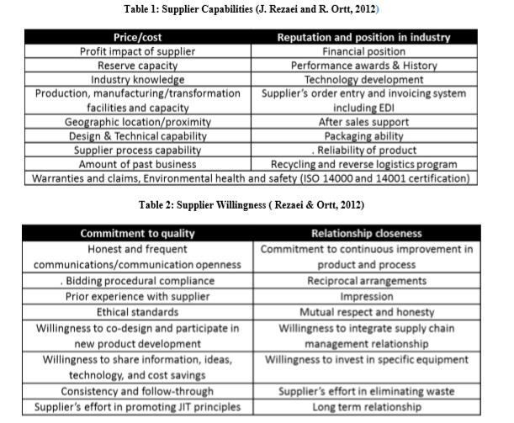
Procurement Optimization – Vendor Rationalization Framework
Product Segmentation Framework
Krajic Matrix | Low Risk | High Risk
Low Profitability
High Profitability | Leverage | Strategic
Vendor Segmentation Framework
Rezaei & Ortt Matrix | Low Capability | High Capability
Low Willingness
High Willingness

Slide 60
Procurement Optimization – Should Cost Modeling
Need for Should Cost Analysis
Should Cost Analysis –Price Negotiation
Highly Engineered
Cost to Supplier
Strategic Sourcing
Should Cost Analysis
Should Cost Analysis
Strategic Sourcing
Strategic Sourcing
Labour Cost
NEGOTIATED PRICE
Many Suppliers
Few Suppliers
Material Cost
Mark up Cost
Margin
Commodity

Slide 61
Procurement Optimization : Price Forecasting
DATA COLLECTION
DATA SEGMENTATION
ALGORITHM
FORECAST VALIDATION
FINAL FORECAST
Trail data
Price Forecast
Historical Price
Forecasting Algorithm
Accuracy measurement
Test demand
Price Drivers
Error noise check

Slide 62
Procurement Optimization : Strategic Supplier Optimization
SUPPLIER
Internal Supply Chain
CUSTOMER
Supplier 1
Supplier 2
Supplier n
Supplier 3
CUSTOMER 1
CUSTOMER 2
CUSTOMER n
CUSTOMER 3
Internal Supply Chain
Supplier – Customer Mapping
Supplier Selection Engine
SUPPLIER SCORECARD
OBJECTIVE

Slide 63
LatentView Capabilities – Case Studies

Slide 64








Demand Forecasting & Advanced Demand Analytics
Innovative Demand Forecasting
Advanced Analytics Use cases
Demand forecasting of First week of Music Album sales using social media
Building Go-To-Market Playbook for potential markets (Power toothbrush)
Hybrid Forecasting for Games using Social & Internal data
Behavioral Analytics to drive personalized recommendation & increased Sales
Demand forecasting for operations planning for home services in retail
Increasing Manufacturing Throughput using IoT analytics on manufacturing sensor data
Predicting vehicle risks by profiling driver behavior in Connected Vehicle
Trends Forecasting for new product demand in Jewellery
Managing demand shifts & uncertainty using internal & external data
Enable Consumption - Visualization

Slide 65




Xbox
360

Slide 66

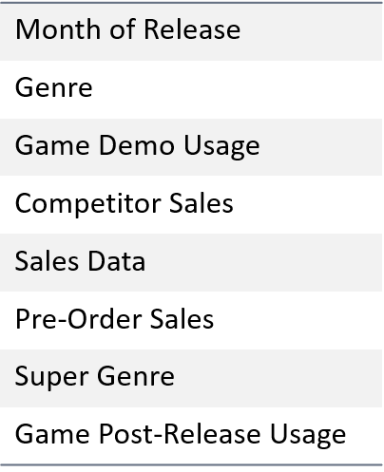
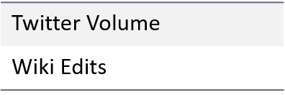
Game Sales Forecasting
GAME SALES FORECASTING
BUSINESS OBJECTIVE
INTERNAL DATA
Forecast 30 days unit sales of game titles that release in the ecosystem
APPROACH
Two models are used depending on the time of forecast:
A BASS Diffusion Model - When the date of forecast is more than 180 days from the date of game release.
Linear Model - when the date of forecast is less than 180 days from the date of game release.
BASS MODEL
LINEAR MODEL
EXTERNAL DATA
More than 180 days before release
180 days before Title release
60 days before Title release
30 days before Title release
Title Release
Back

Slide 67

Game Sales Forecasting
GAME SALES FORECASTING
For a popular multi-player video game,
PREDICTED SALES
FORECAST DONE 180 DAYS BEFORE RELEASE DATE
ACTUAL SALES
FIRST 30 DAYS
1.25M
900K
Sales | M_-5 | M_-4 | M_-3 | M_-2 | M_-1 | M | M_1 | M_2 | M_3 | M_4 | M_5 | M_6
DESTINY | 0k | 0k | 1k | 10k | 128k | 357k | 57k | 4k | 0k | 0k | 0k | 0k
DESTINY 2 | 0k | 0k | 2k | 25k | 324k | 900k | 143k | 10k | 1k | 0k | 0k | 0k
LINEAR MODEL FORECAST
FORECAST DONE WITHIN 30 DAYS BEFORE RELEASE DATE
PREDICTED SALES
TWITTER BUZZ
UNIQUE USERS
FIRST 30 DAYS
6 MONTHS AGGREGATED
6 MONTHS AGGREGATED
471K
59K
4.5M
Back

Slide 68
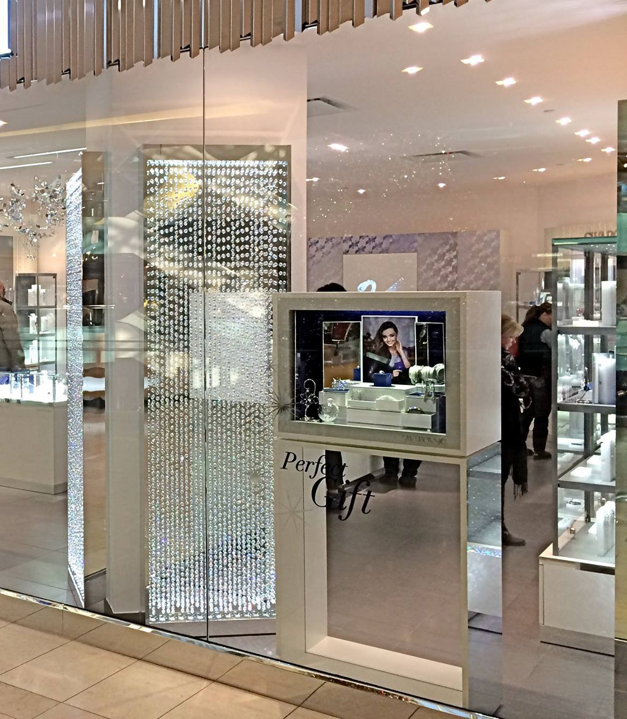

Fashion
&
Jewellery

Slide 69
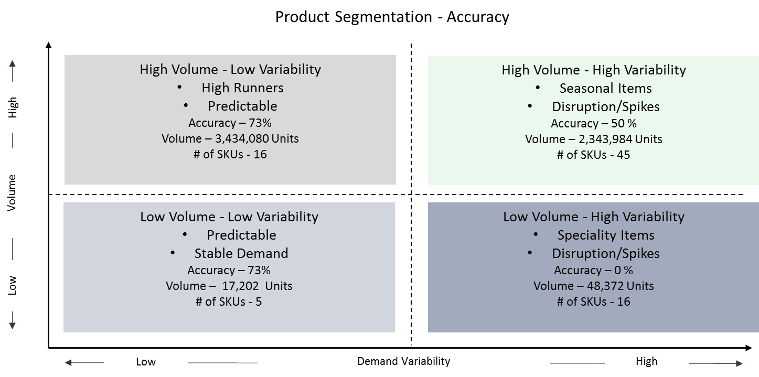
Sell in Demand Forecasting for Jeweller
Business Objective
Generate accurate forecasting of sell in shipments to retail stores
High variabilities & issues on current forecasting methods.
LatentView’s Solution
Ensemble of techniques: ARIMA, TBATS, STLF & Neural Networks
Segmented to approach to factor fashion industry demand that changes in Non-linear ways
Special attention on New products & Long Tail Products (Replacement, New to company & Product Line Extensions
Quarterly correction process through model training methods
Gold Prices were key drivers of demand in developing markets
Business Benefits
Increased accuracy of the problematic long tail & high velocity segments
Process correction: Data driven judgements in combination with market expert Judgements esp. for high variability segments
Back

Slide 70

Diesel
Cars

Slide 71

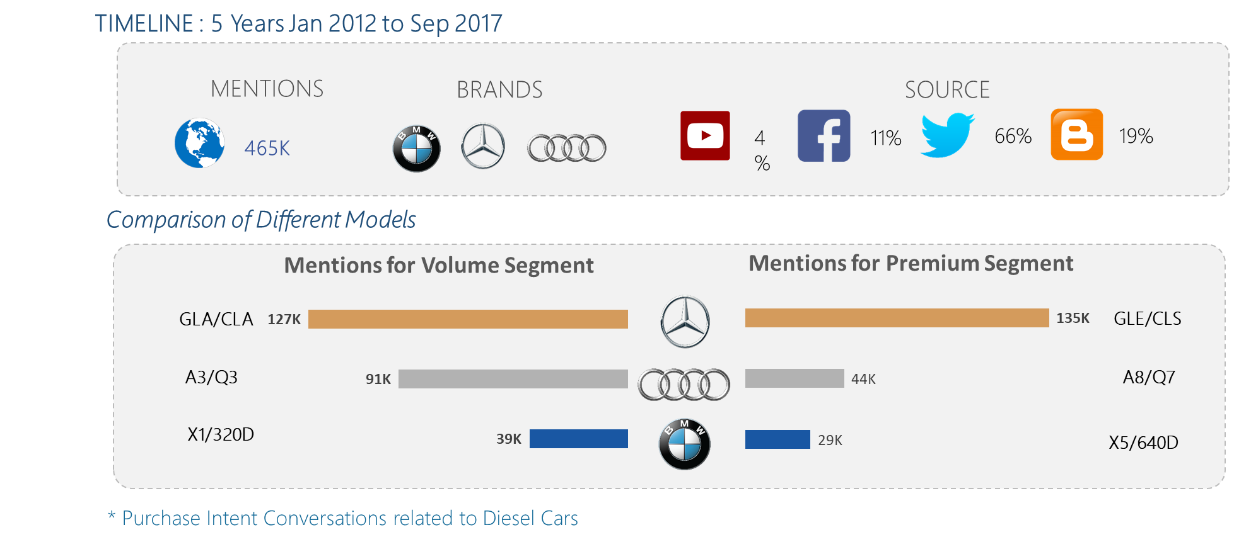
Impact of Diesel Scandal in Diesel Car Demand
Demand for Diesel Cars = f(Purchase Intent in social media)
Keywords that define Purchase Intent:
“Intent to Purchase is the when user expresses an actual desire for a product rather than generally talking about a brand or their product.”
“Where to buy, Looking for, Purchase, Want to buy, Where to buy, Need quote”

Slide 72
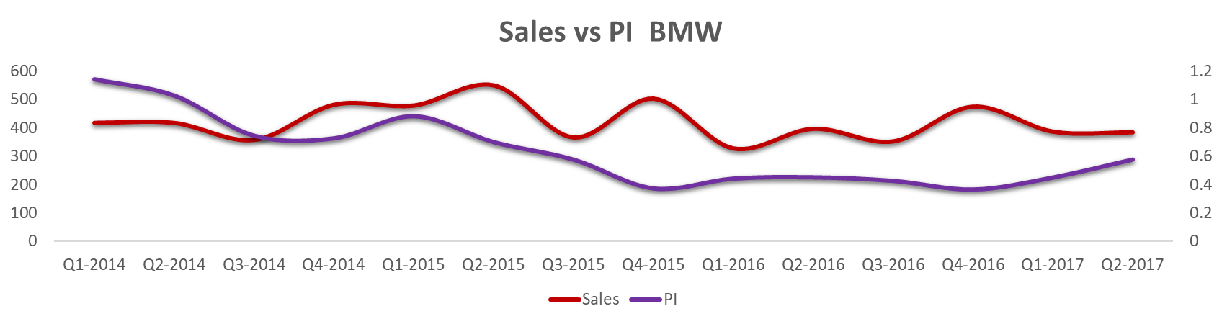
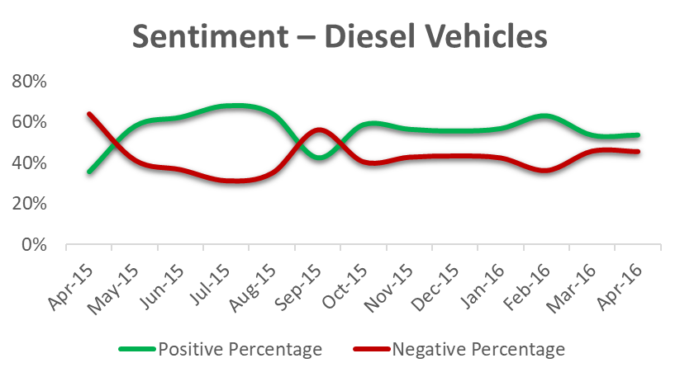
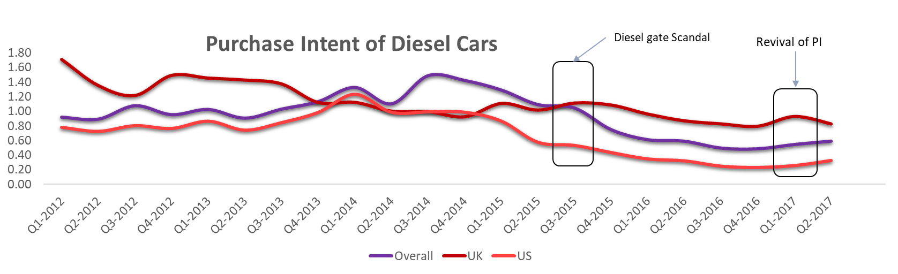
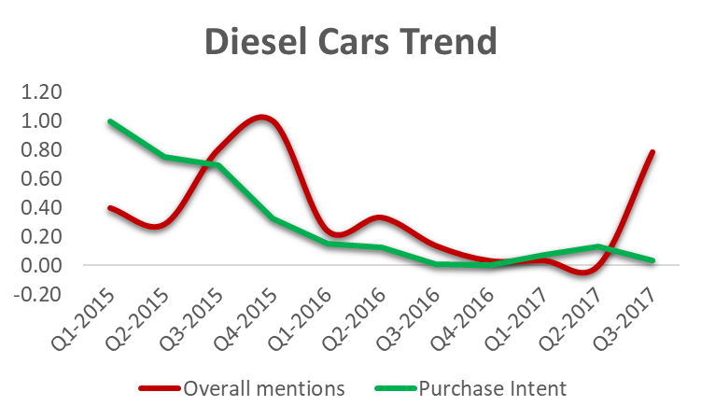
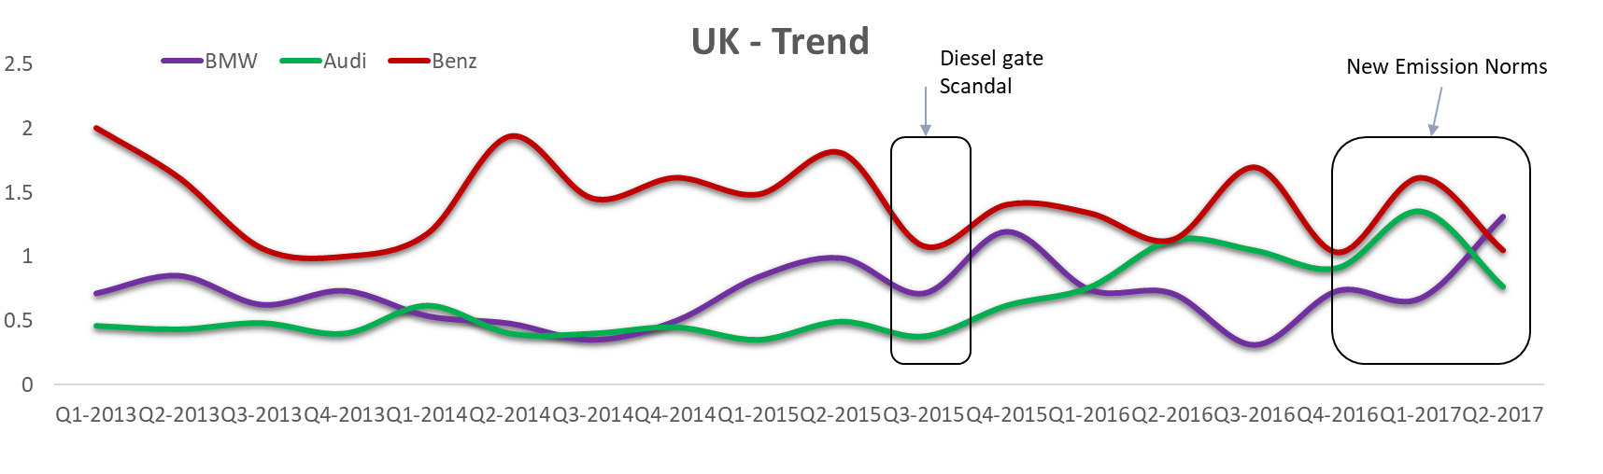
Impact of Diesel Scandal in Diesel Car Demand

Slide 73



Impact of Diesel Scandal in Diesel Car Demand – Premium Cars
2014 Audi A8 Limited version(50 units) and L security system.
Immediate Demand Drop: 36%
Within a Year: 48%
Pre launch of M version of X5
Benz CLS Update and Facelift
73
Drop in Audi due to Scandal

Slide 74


Impact of Diesel Scandal in Diesel Car Demand – Volume Cars
Immediate Demand Drop: 36%
Within a Year: 43%
BENZ CLA launch
& Competition
X1 2014 Facelift updates:
Redesigned Air Intake
Alloy wheels with V-spoke
New Body Color option
Drop in Audi due to Scandal

Slide 75
Prognosis Analysis – Areas of Work
F = (Volume Development, Sentiment, Top themes, Pdt features, Competition)
Use Case | Question
SUV/SAV-categories | Is volume development in the different SUV categories (KKL / MKL / GKL) identical? Are life cycles in these categories comparable? Do these categories function as a substitute for each other? Can these SUV categories be equally substituted outside this segment?
SUV/SAV-Boom | How long will the SUV/SAV boom last? At which point will stagnation in this segment occur? When would a decline in demand be expected?
Volume development of roadsters | How does the volume development of this product look like (absolute / life cycle)? Is a derivation from previous models (Z3 / Z41 / Z42) constructive since these were based on different concepts?
Prognosis of life cycles | How does derivation of life cycle curves of different derivatives look like at an early stage? How does product measures and external factors influence lifecycle curves?
Leading indicators (early) | Would it be possible to predict early indicators in market behavior, e.g. support for electric vehicles in Norway and their lack of infrastructure after this boom (SZ 14 September 2017)? Would it be possible to be aware of an early detection of political decisions such as promotions of electric vehicles or diesel bans possible?

Slide 76

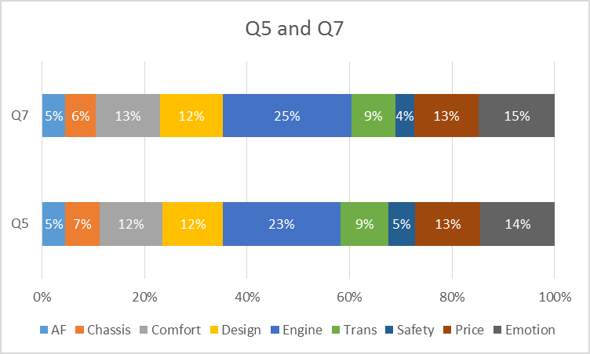
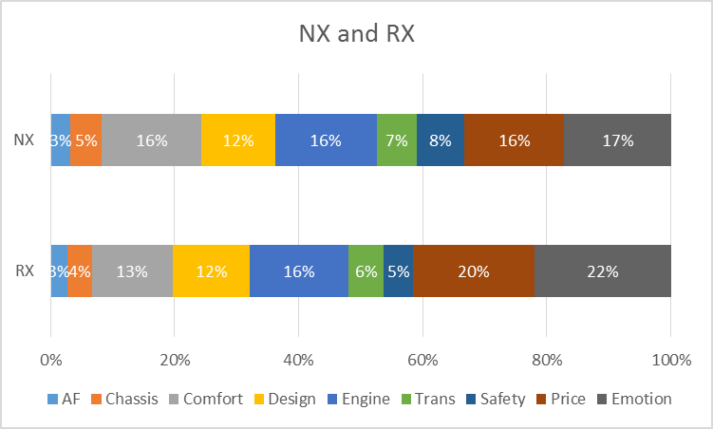
SUV/SAV Categories
Do these categories function as a substitute for each other?
- MKL-KKL SUVs are often discussed together and X5/Q5 is the most commonly discussed models
MKL-KKL are the closest substitute categories. Further analysis shows that X5 (MKL)-Q5(KKL), X5 and X3 are the closest substitutes and have very similar signature and purchase intent
Social Mentions
Association Analysis
Model Associations in MKL-KKL
“Q7 i strongly feel is too big for our congested roads. Look at Q5 its a good option. Dont look at Q3 its hatchback basically.I still suggest X5 or even X3”
"What car should I buy next.? Looking for SUV , budget 30k. Options: BMW x5 2013 Audi 2014 Q5 Acura 2014 MDX Mercedes 2014 glk 350 I am looking for a quiet and powerful rude. Looks matter too. Location US EAST COAST"
Category Associations | Confidence | % Comparison Volume Share
MKL-KKL | 25% | 32%
MKL-KKL-UKL2 | 16% | 16%
GKL-MKL-KKL | 14% | 12%
KKL-UKL2 | 12% | 23%
GKL-MKL | 9% | 17%
Model Associations | Confidence | % MKL- KKL Volume Share
X5 – X3 | 33% | 44%
RX-NX | 19% | 12%
Q5-Q7 | 16% | 25%
Signature of Conversations involving X5-X3

Slide 77
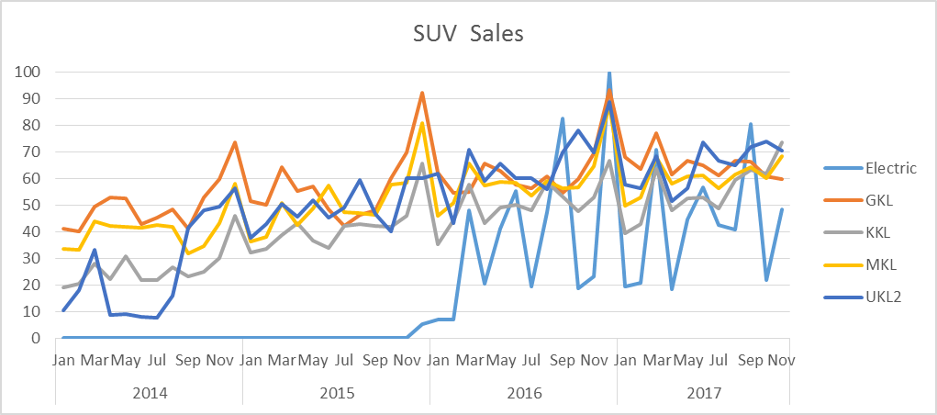
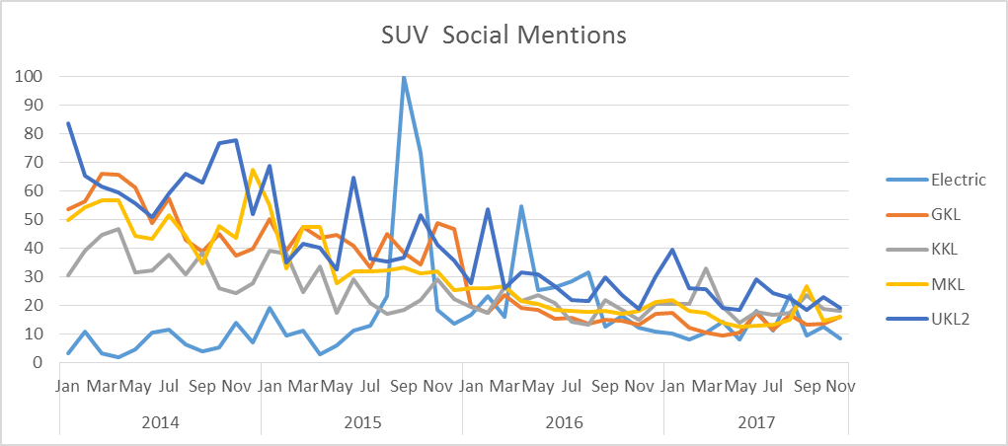
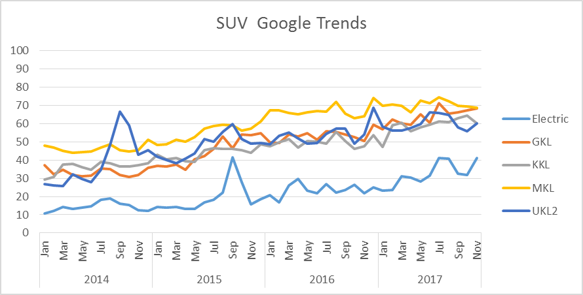
SUV/SAV Categories
Is volume development in the different SUV categories (KKL / MKL / GKL) identical?
- Volume development is identical for all the categories based on Sales, Search and Social Mentions
SUV Sale
SUV Social Mentions
SUV Google Trends
Category | %YoY Sale
Electric | 18%
GKL | 6%
KKL | 16%
MKL | 7%
UKL2 | 7%
Category | % YOY mentions
Electric | -35%
GKL | 1%
KKL | 8%
MKL | -8%
UKL2 | -4%
Category | %YOY avg searches
Electric | 54%
GKL | 25%
KKL | 23%
MKL | 7%
UKL2 | 15%
MKL has the highest demand followed by KKL models
GKL KKL especially follow very similar pattern in sales
GKL has the highest social mentions mainly due to Range Rover
The relative volume in social media has been declining. Correlation between sales and social mentions (PI??) are not reliable for SUV
GLA, GLC, GLE, Lexus NX, Q3 and X4 were introduced between 2014 and 2015, so their initial buzz have been high
Contrary to Social Media, web searches have been on an increasing trend and almost all categories exhibit similar pattern
BMW ModelX and Mercedes Benz ModelY have strong correlation in their sales and Search metrics. Their Volume development are similar and are drive by similar factors

Slide 78
Roadster Categories
How Does The Volume Development Of This Product Look Like (Absolute)?
Comparing the strength of the relation in sales and search volumes of competitor roadsters
BMW ModelX and Mercedes Benz ModelY have strong correlation in their sales and Search metrics. Their Volume development are similar and are drive by similar factors
Data sources:
Google Trends
Sales data from Carsalesbase.com
Time Period:
January 2014- November 2017
Back

Slide 79
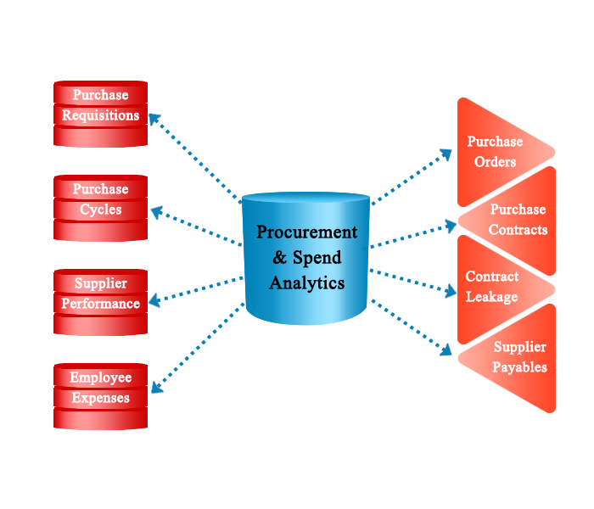
Spend Analytics

Slide 80
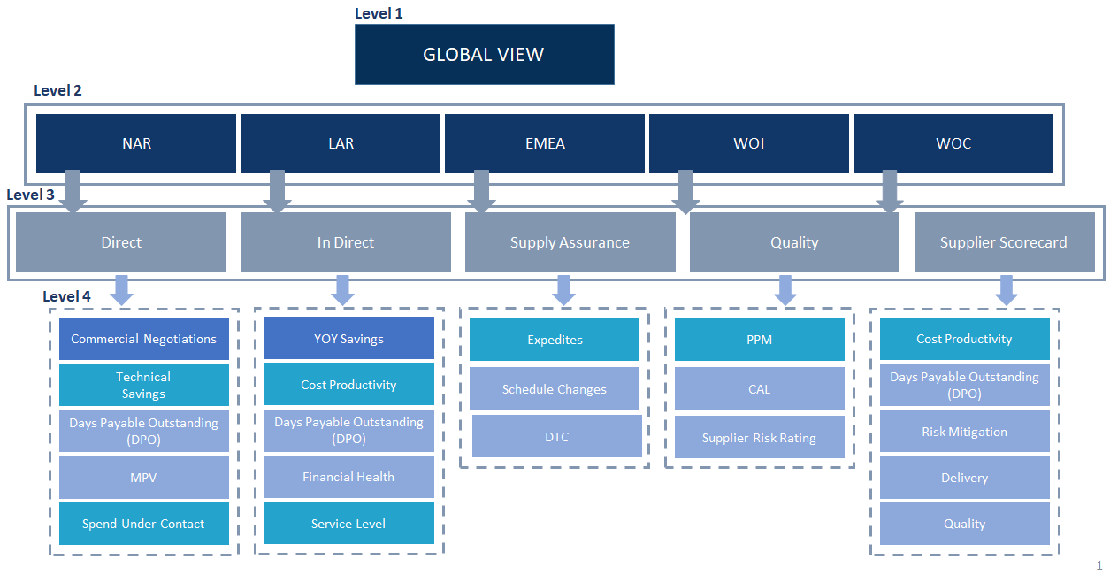
Spend Analytics and Supplier Performance dashboard to better utilize the Spend under contract
The Problem : Visualize the Supplier Performance and effectively utilize the Spend under management through bottleneck identification
The “Before” State
LatentView Solution
The “After” State
Spend under management is exceeding the budget by ~15% on an average for the past one year
Early warning indicator to identify leakages through real time visualization dashboard to slide and dice the spend components
Controlled Spend under management with in target and smart allocation
Supplier Scorecard to asses supplier performance
Features
Framework
Smart Spend management decision enabler
Real time spend bottleneck visualization
Supplier Performance visualization
Advanced Analytics visualization tool

Slide 81

Route Optimization

Slide 82
Supply Chain Analytics – Inbound Logistics Overview
Business Challenge
As the federal safety regulation that restricts hours on the road comes into play, there is a serious shortage of qualified truck drivers. Marketplace dynamics are driving wages higher, pushing up labor cost & cost per mile
Problem Statement
Higher vehicle utilization
Minimize the route time for a truck to start and return to a CDC covering all allocated suppliers by maximizing the vehicle utilization
Complexity
XXX Suppliers
400,000 + SKU’s
180 + DC’s
450,000 + Customers
1.3 Billion Cases/Year
Benefits
Higher vehicle utilization
Lower fulfillment response time
Lower Inbound transportation costs

Slide 83
Sysco Supply Chain Analytics – Inbound Logistics Overview
Business Challenge
As the federal safety regulation that restricts hours on the road comes into play, there is a serious shortage of qualified truck drivers. Marketplace dynamics are driving wages higher, pushing up labor cost & cost per mile
Approach
Optimize vehicle capacity utilization
Optimize the fulfillment Leadtime
Optimize Product truck allocation
Reduction of Inbound Logistic costs
Optimize vehicle capacity Selection
Allocate Vehicle Capacity to Supplier
Operations Research

Slide 84
Supply Chain Analytics – Inbound Logistics Solution detailed
Inputs
Methodology
Critical Outcome
Optimize vehicle capacity utilization
Number of Vehicles
Is the current capacity enough to suffice all demand capacity?
Supply Vehicle Optimization
Maximum trips
How much of each of the vehicle’s capacity will be used to suffice each of the suppliers wise demand capacity?
Vehicle and Demand Capacities
Optimized Supply Demand Capacity Model
Number of vehicles and the trips needed to match Demand and Supply Capacity
Average Unit Freight Cost
Network Map
Optimize the Fulfillment time
What is the optimal path to be covered with shortest distance by a vehicle traversing all the identified suppliers
Route Lead time Matrix
Vehicle Shortest Path Model
Starting node
Ending node
Which SKU should be loaded into a particular vehicle?
Vehicle Identifier
Optimize product truck allocation
Supplier ldentifier
Demand Capacity Item Allocation Model
How much Capacity of each SKU should be loaded into each vehicle?
SKU Capacity Contribution
Vehicle Capacity Contribution
Vehicle Capacity Contribution

Slide 85
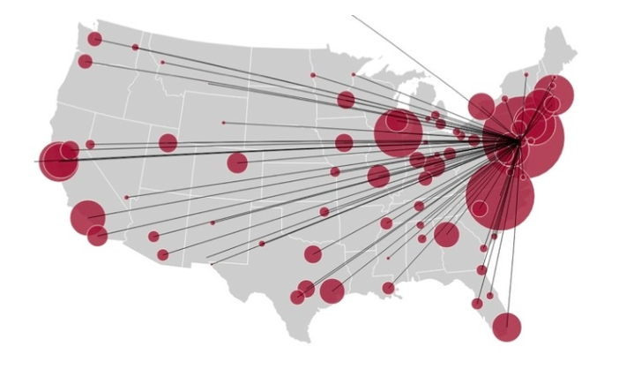
Contextual Visualization
-in Supply Chain

Slide 86


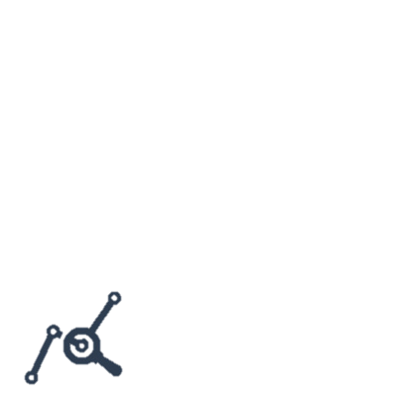
Visualize : Automated Inventory Diagnostic Tool
Levels of Granularity
Identifying Insufficient and Excess Inventory
Set and Refresh Inventory Targets
Analysis of Improvement Scenario
Sector/Sub Sector/Country
Material Attributes
Business Segments
Supply Chain Health
Inventory Analysis
SKU Analysis
Component Overview
Safety Stock Analysis
Cycle Stock Analysis
In Transit Analysis
Pre-Build Analysis
Scenario Analysis
Goal Setting Analysis
What-if Analysis
Business Objective
LatentView’s Solution
Business Benefits
To provide a starting point for the analytics dimension of inventory management capabilities
To identify average excess inventory levels and set smart targets by SKU and location
To identify ‘near term’ inventory reduction opportunities
To understand key operational drivers
Dashboards were built using Tableau to provide an end to end solution illustrating the flow of Inventory for both Raw Materials and Finished Goods
A logical flow of dashboards was built which provided a holistic snapshot of the supply chain network , capturing the key governing parameters from a sector level to an SKU level
Developed a What-If analysis framework providing the user a platform to simulate different scenarios and hence identify the optimal method to reduce excess inventory.
Provides better inventory planning in the warehouses thus reducing the cost of carrying goods and also avoid stock-outs
Identifies the opportunities for improvement from a Sector level up to a SKU location level using the key performance indicators for various inventory components
Back

Slide 87
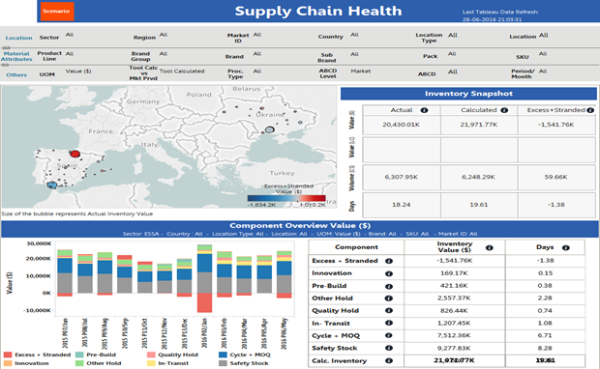
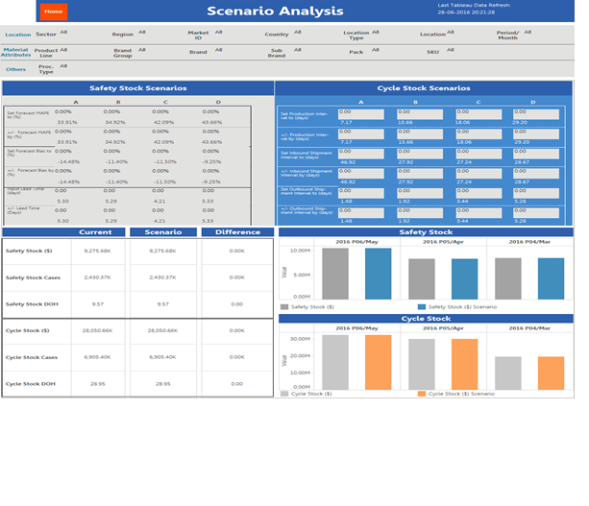
Visualize : Automated Inventory Diagnostic Tool
Online Demo possible
Back

Slide 88
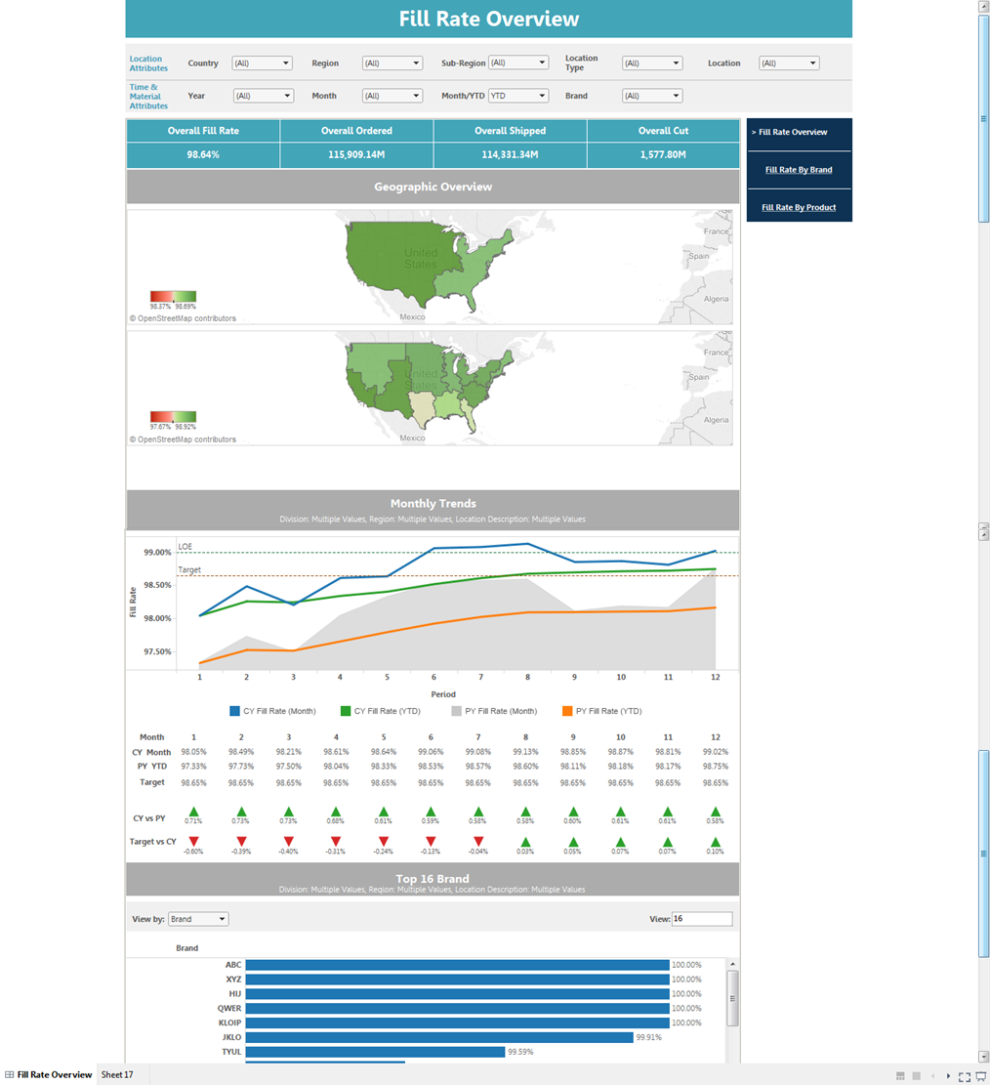
Visualize : Supply Chain Metrics Dashboard
Dashboard
Supply Chain Performance Award of Excellence
Site Metrics Overview
Metric Deep-dive
Manufacturing
Logistics
Warehouse
Service Metrics
Cost Metrics
Quality Metrics
People Metrics
Fill Rate
Days on Hand
% On Time Delivery
+more
Business Objective
LatentView Solution
Business Benefits
To provide a starting point for consolidation of various supply chain metrics and standardize across various supply chain planning teams
To identify the underperforming locations/products and understand the possible reasons involved
Created automated visually represented reports using Tableau comprising of Supply Chain Metrics based of existing data in enterprise data warehouse
A logical flow of dashboards was built which provided a holistic snapshot of the supply chain performance starting from the overall Supply Chain Performance Awards of Excellence to supply chain performance deep-dives
The BI layer helps monitor & compare performance metrics across various geographic levels and product hierarchy in order to identify areas for improvement
The BI layer is the consolidation of metrics across functions which helps client in strategic decision making
Back

Slide 89
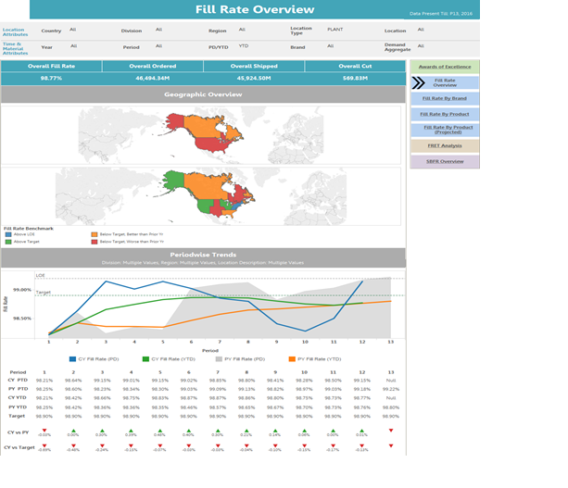
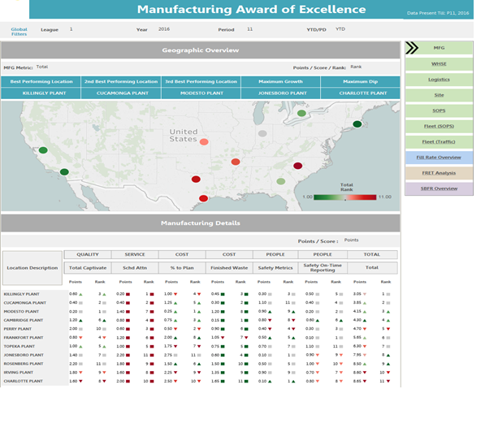
Visualize : Supply Chain Metrics Dashboard Screenshots
Online Demo possible
Back

Slide 90
Next Steps to be added..
Tools & Technologies
Analytics techniques
Case Studies

Slide 91

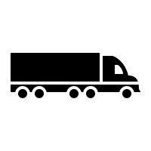

Examples of some of our previous work
Leveraging IOT sensor data to mine insights on driving patterns
Enabling cloud infrastructure to generate real time product recommendations
Improve service levels by leveraging analytics on multiple segments across supply chain
Leading German automobile player
Leading Food distribution company
Leading Home Appliance Repair Services provider
Profile Driver behavior to predict vehicle risks and estimate warranty costs using IOT data
Converge data from silos into a centralized cloud based platform to build a recommendation engine
Enhanced the business performance from existing 45% to 95% service levels that impactted13 Million Customer Service requests annually

Slide 92

1. Profile driver behavior using IOT sensor data
LatentView developed and delivered SMART INSIGHTS tool, a scalable and self-service platform for analytics on connected vehicles
Solution
TECHNOLOGY State of art open source technologies like Scala, Spark, Data bricks
SCALE Built on 4.5 million cars & 2.8 Million Warranty Claims across multiple geographies
AGILE Delivered under 6 months
INNOVATION Superior analytical capabilities through simplified user experience
Key Highlights
Complexity
IOT Data from cars all over the world, merged with local warranty claims and built Machine learning solution on top of it
Features
Exploratory Analytics
Warranty vs Features
Vehicle Segmentation
Risky Neighbours
Analysis
Connect Product Usage with Warranty Repairs & Features
Predicting Risk for Similar Profiles
“Cars showing Short Trip & Long Pause behavior have a 40% higher chance Engine related failures”
Vehicles that spend 100% more on Pedal position are at a 250% risk of engine related defects.
Sample
Insights
Demo

Slide 93



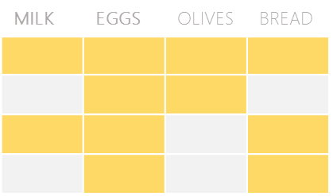

2. Recommendation Engine for food distribution company
The Problem: In an industry where customer acquisition is fairly expensive, this company’s repeat orders were at a low 4%
The “Before” State
LatentView Solution
The “After” State
Sales teams tried to sell new products to existing customers based on shallow analysis of previous transactions and ‘gut’ feel
Build an innovative recommendation engine that combined customer segmentation, user-based collaborative filtering and market basket analysis
20% increase in value of new orders from existing customers. Higher customer satisfaction due to precise recommendations
Collaborative Filtering
Market Basket Analysis
Items Purchased:
Items Purchased:
Market Basket Analysis performed for all products bought by customers in a segment. Select the product with highest likelihood to co-occur in the basket
Similar
Customer B
Milk
Eggs
Milk
Eggs
Bread
Customer A
Customer C
TRX1
Milk
Eggs
TRX2
Recommend Bread
User-User Similarity - similarity is calculated between customers within a segment based on common products in basket using Cosine Similarity
TRX3
Recommended
Bread
TRX4
Recommendation Engine
Combine the recommendations from the 2 algorithms to generate the final recommendation
For a Customer who purchases Milk & Eggs, the product with highest affinity is Bread

Slide 94



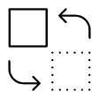

2. Scaling up the machine learning solution to Big data
Built a product recommendation system for a leading food distribution company
and later scaled it up to include all 72 op-cos and all geographies leading to ~20% increase in the new orders by existing customers
Phase 2
Big data platform providing Machine learning solutions for 72 op-cos
Phase 1
Enabled Distributed processing and data pipelines for data across geographies
On Premise machine learning solution for 7 op-cos
Custom built cloud based tool delivering insights like:
Recommendation system for cross-sell opportunities (customers & deals)
Next best product recommendation
Data dimensions
Customer Segmentation
Customer
Order Anomaly Detection
Transaction
User Based Collaborative Filtering
Product Substitution
Geography
Market Basket Analysis
Revenue Management Use Cases
Products
Price
Final Recommendations
Real time recommendations
40K customers data
36X faster than linear approach
Serves 72 op-cos across USA

Slide 95

3. Improving Home Service Requests Operational Efficiency
Objective : To enhance the customer service request fulfilment rate from existing 45% to 95% for ~13M Customer Service requests annually
Approach: Disintegrated the business goals into 3 key business processes that needed attention and build a scenario simulation tool
1
2
3
Business Process
Demand Planning
Workforce Planning
Inventory Planning
Scenario Simulator
High variance between forecasted demand and actuals
Delay in tech allocation and scheduling
Replacement Parts not available
Focus area
More granular forecasting to match supply
Optimize tech allocation for granular demand
Optimize truck stock and order – tech – part match
Analytics Solutions
Reallocation of supply in response to gap/surplus
Accuracy up to 92% from 65% reducing lead time by 20%
$5 million per annum in incremental revenue as a result of reduced cancellations
10% reduction in reschedules, resulting in lower trips per repair
Enabled identification of $300,000 opportunities every year
Impact
1M parts and 1.2 million calls data processed in 12 weeks across 40 districts and 8K segments
Advanced forecasting techniques which integrate external factors like weather, holidays etc.
Integration with the existing infrastructure/tools and data ETL support
In use by 100+ capacity planner and managers

Slide 96
Forecasting
LatentView Confidential

Slide 97




Helping a video game company with precise forecast
Challenge:
In the case of gaming and other creative content driven industry, historical data is not enough to predict the sales volume of new releases
Solution:
Leveraged External data ( Social media, forums, etc. ) to increase the sales forecast accuracy
Improved forecasting accuracy ( 97%)
Existing sales forecast models
(~60% accuracy)
Unstructured external data:
Social media buzz
Forums , Rating portals
&
Model enhancements like making Ensembles, Bass diffusion, etc.
Notes:
Pandora – Demand Forecasting

Slide 98
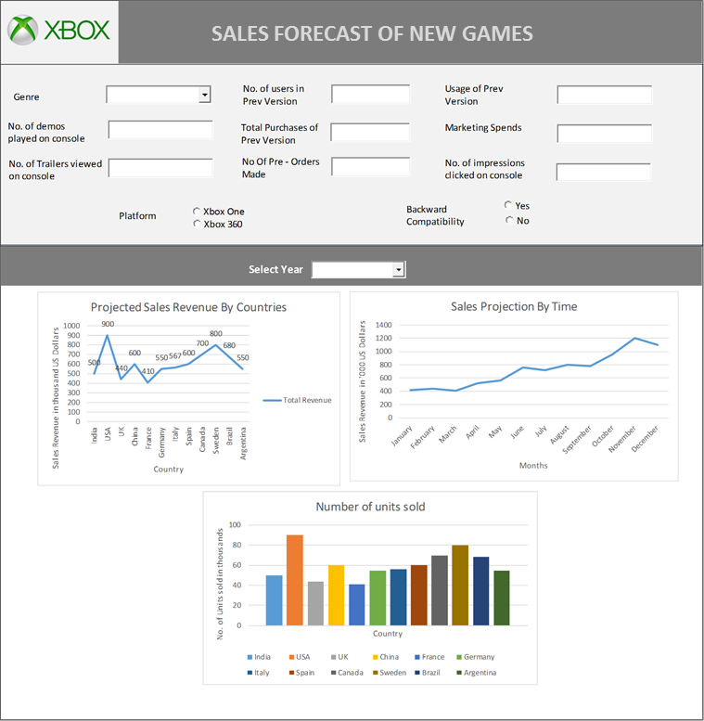





Forecasting 1st Party Game sales - Leverage Internal and External data
Business Context - Forecasting the sales of games that are new to Xbox Eco system, new versions of the games and existing games
Internal Data
New to Xbox
#usage & uu of genre, #demo played on console, # trailers viewed on console,# game impressions clicked on console pre-order information, marketing spends etc.
Model
Multivariate Linear Regression
External Data
#likes of game posts, #shares of game posts, # people talking about the game, total sentiment score etc.
Forecasted Value
#trailers viewed, #likes, #dislikes etc.
#twitter followers of game page, #retweets of trailers etc.
ACTUAL SALES
FORECAST DONE 180 DAYS BEFORE RELEASE DATE
AS ON 10-06-2017
1.3M

Slide 99



Precise Forecasting of Demand for Jewelry SKUs
Challenge:
With frequent new SKUs additions in the portfolio, the demand forecasting is not straightforward, as the affinity towards new designs is difficult to predict
Solution:
Built new forecasting models for existing SKUs and leveraged advance analytics techniques like similarity scoring to increase the forecast accuracy for new SKUs
58% existing accuracy
33% existing accuracy
Existing SKUs
Similarity scoring
New SKUs
65% new accuracy
50% new accuracy
Volume forecast (existing)
Volume forecast
(new)
Overall forecast
Overall 63% accuracy
Notes:
Pandora – Demand Forecasting

Slide 100





Precise Forecasting of Demand for Jewelry SKUs
World’s 3rd Largest Jewelry Manufacturer
The Problem: Accurate demand forecasts for new and existing SKU’s is essential in a vertically integrated supply chain for high value products
The “Before” State
LatentView Solution
The “After” State
Lack of consensus on demand forecast across different business functions and no centralized category level forecast was further complicated by the frequent introductions of new products every year
Generated baseline forecasts for 3000 SKU’s using multivariate forecasting techniques and driving consensus among demand planners. Automated new SKU forecasts using similarity indices to identify most similar old SKUs
Improved overall demand forecast accuracy by 13% and availability of SKU level forecasts helped reduce supply planning costs by 2%
Existing SKUs
New SKUs
Fit the models from the subset identified above to the in-sample data and collect statistics on the out-sample
Calculate similarity indices for new SKUs to identify most similar old SKUs
Add following variables to the data
Subset Data
Determine if the time series requires any additional transformations
Net Weight
Weight Gold/Silver
DNA Metal
US Retail Sale price
DNA Stones
DNA Colour
Choose the model with the best accuracy to fit the whole range of data
Choose the model with the best accuracy to fit the whole range of data
Repeat the process for all SKU’s
Identify and flag poor performing models for manual corrections
Clustering of SKUs
Use business inputs to fine tune models
ARIMA
STLF
Neural Networks
Croston’s
Tbats
Prophet
K- Prototypes
PAM
Notes:
Pandora – Demand Forecasting

Slide 101
Expertise in cloud platform
LatentView Confidential

Slide 102


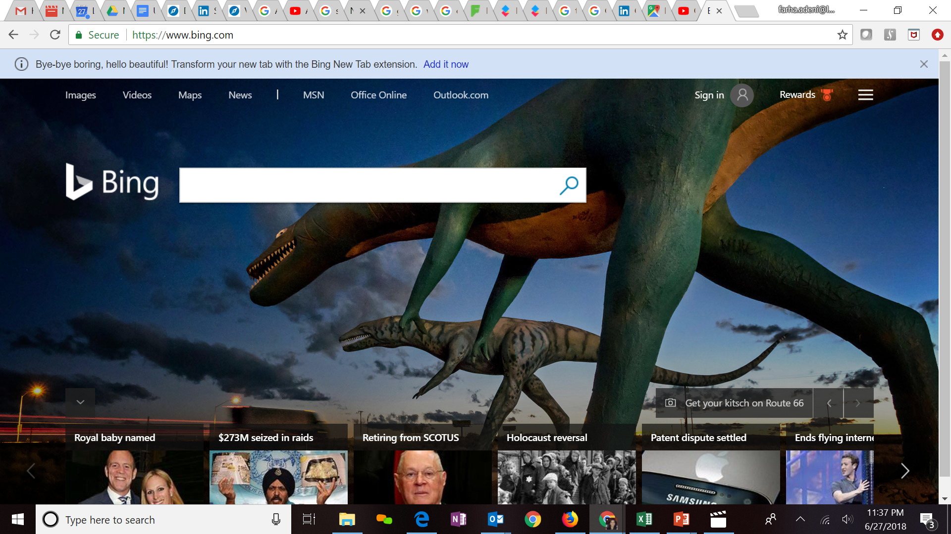



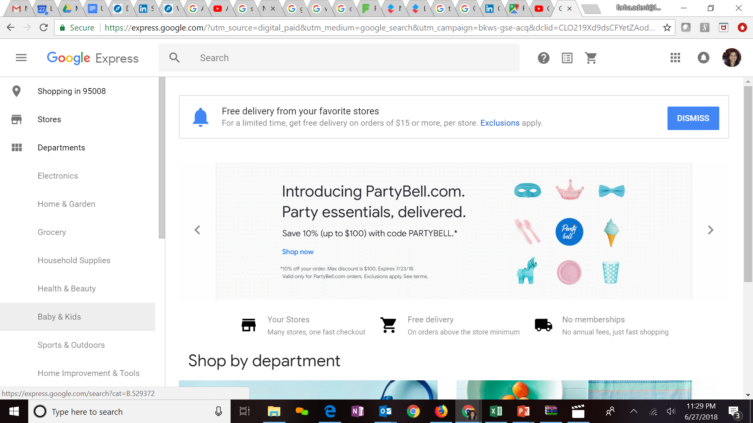



Expertise in Cloud platforms
Key Clients
LatentView is a Microsoft Gold Analytics Partner
Model Automation Framework – LatentView scalable ML solution built in Azure hosted on Microsoft Appsource (link)
Key Participants of MS Tech-ED 2014, Azure Training
Managed Analytics in Azure using AzureML, PowerBI, Azure data factory, Azure Search, Azure data lake analytics etc.
LV is Advanced Analytics Consulting Partner
Key Presenters of AWS Re-Invent, Business Summit
60 TB cloud migration exercise completed in 3 months
Processing 500+ GB unstructured data per week
Multiple enterprise solutions deployment experience
Managed Analytics in AWS using Amazon ML, Cloudsearch, Kinesis, QuickSight etc.
Extensive experience in handling GCP products- AppScript, CloudSQL, Appmaker, Big Query etc. Deep Technical Capabilities to work in this platform
Multiple solutions deployment experience for Google projects
Managed Analytics in GCP using MapR, Cloud ML, Cloud dataflow, Google data studio, Cloud SQL
Notes:
Q – Anup can you update some of the details

Slide 103
Other Case studies
LatentView Confidential

Slide 104
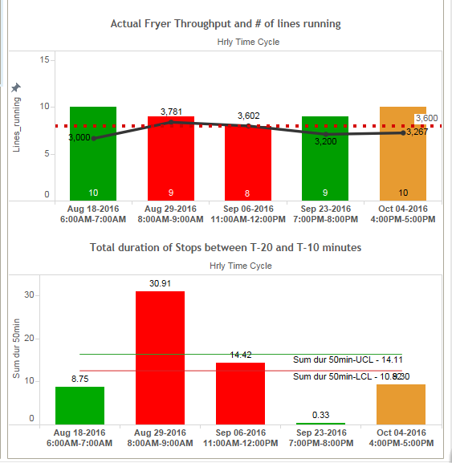






Increasing Manufacturing Throughput Thro’ Machine Learning for leading snacking company
The Problem: Low capacity utilization of expensive equipment that adversely impacts production throughput to the extent of 6%
The “Before” State
LatentView’s Solution
The “After” State
Large Equipment in the manufacturing line like Fryers for chips operating well below capacity at 90%
Early Warning System based on Logistic Regression to predict downtime in processing line – 30, 60 & 180 minutes in advance
Fryer utilization up to 98.5%
$ 2 million savings in cost per fryer
Potential save of $ 50 Million after rollout to 30 plants across US
I Data Understanding
II Data Preparation
III Model Building
IV Real Time Dashboard
2 Interleaved Master Database
1 Data Sources :
Extracted only 1 hour data prior to target event
Defined Non-Event and Applied various conditions on 1-hour time frame
Packaging Stops
Through put change
Processing Stops
Event Subset file
Non-Event File
Operational Variables
i. Collated file in Time series format
ii. Converted time –series data into cross sectional form
Logistic Regression to predict downtime and throughput reduction and to identify Key Factors
4
3 Data Mart for Model building

Slide 105
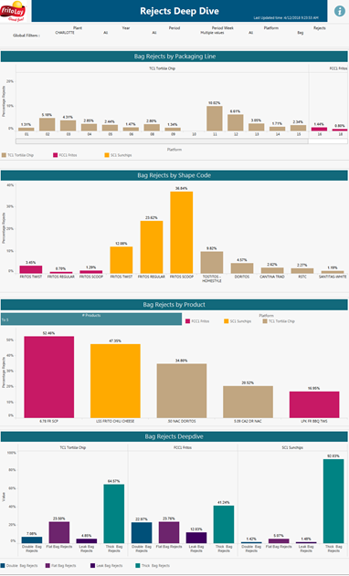
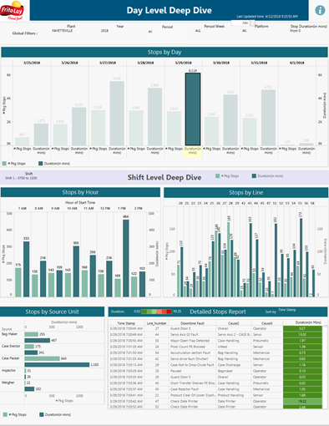
Sample Tableau Illustration

Slide 106
Automated Inventory Diagnostic Tool for a leading beverage manufacturer
Levels of Granularity
Identifying Insufficient and Excess Inventory
Set and Refresh Inventory Targets
Analysis of Improvement Scenario
Sector/Sub Sector/Country
Material Attributes
Business Segments
Supply Chain Health
Inventory Analysis
SKU Analysis
Component Overview
Safety Stock Analysis
Cycle Stock Analysis
In Transit Analysis
Pre-Build Analysis
Scenario Analysis
Goal Setting Analysis
What-if Analysis
Brands
SKU
Business Objective
LatentView’s Solution
Business Benefits
To provide a starting point for the analytics dimension of inventory management capabilities
To identify average excess inventory levels and set smart targets by SKU and location
To identify ‘near term’ inventory reduction opportunities
To understand key operational drivers
Dashboards were built using Tableau to provide an end to end solution illustrating the flow of Inventory for both Raw Materials and Finished Goods
A logical flow of dashboards was built which provided a holistic snapshot of the supply chain network , capturing the key governing parameters from a sector level to an SKU level
Developed a What-If analysis framework providing the user a platform to simulate different scenarios and hence identify the optimal method to reduce excess inventory.
Provides better inventory planning in the warehouses thus reducing the cost of carrying goods and also avoid stock-outs
Identifies the opportunities for improvement from a Sector level up to a SKU location level using the key performance indicators for various inventory components

Slide 107
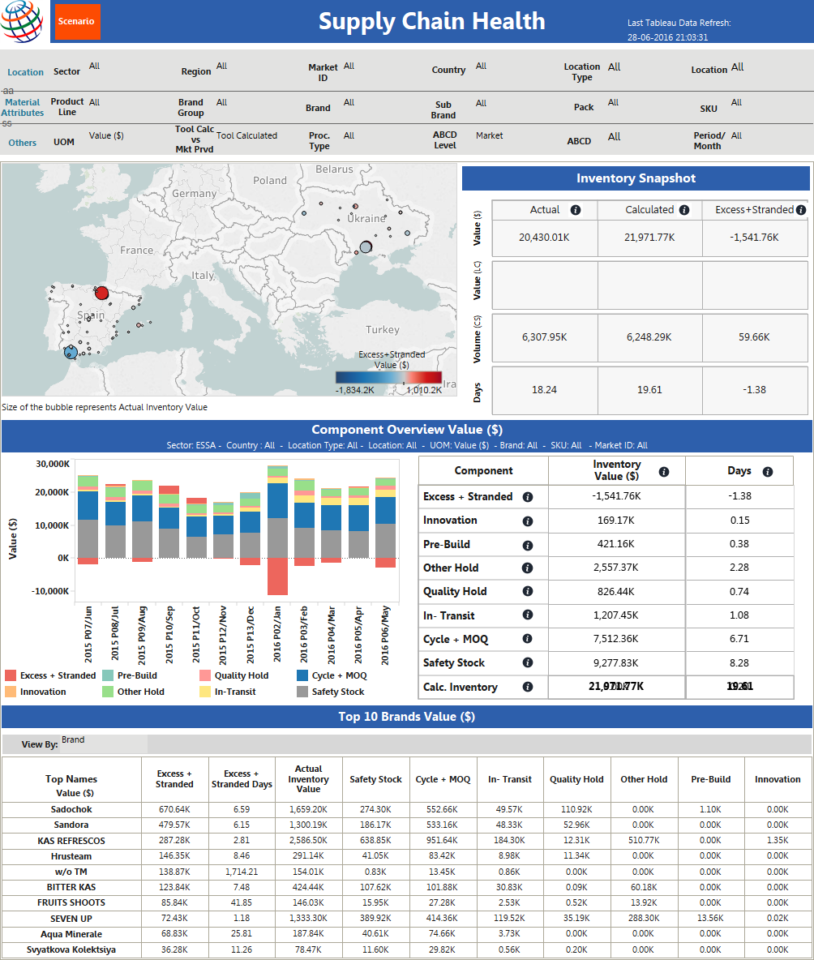
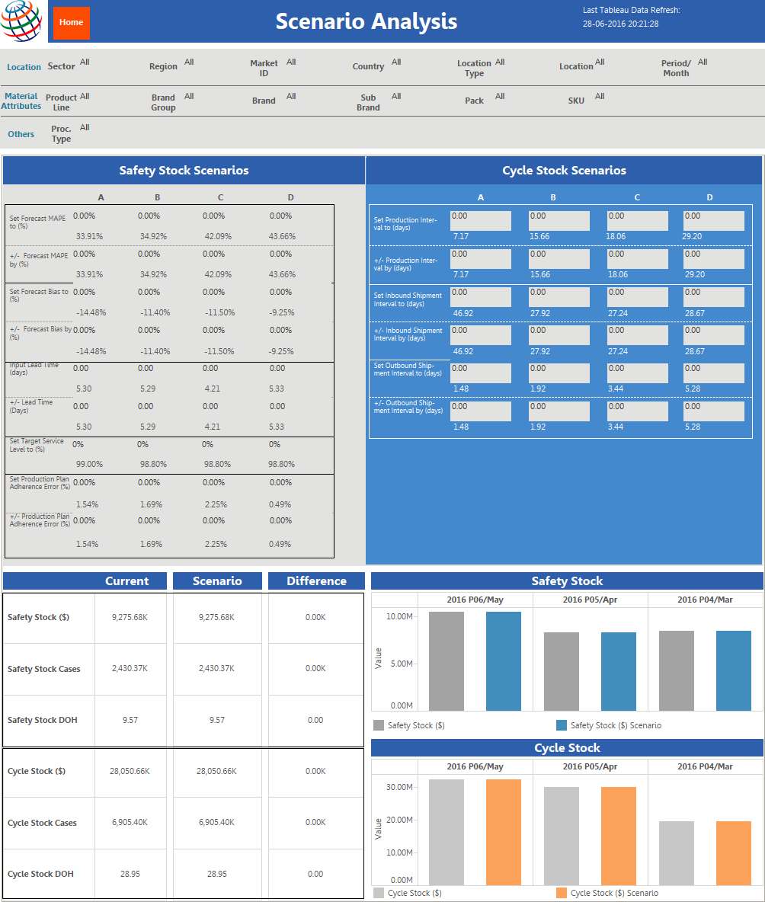
Sample Tableau Illustration

Slide 108
Appendix
LatentView Confidential

Slide 109
LatentView- Data Engineering Capabilities
Applications
Data Strategy
Data Lakes
Data Warehouse
Visualization
Decision management systems
IoT Applications
Data Monetization Roadmap
Cloud Strategy & Architecture
Architecture Evolution
Data Integration / Consolidation / Harmonization Framework
Optimizing BI Investments
Data Engineering
Capabilities
Technology
Engineering
Hadoop: Hive, HBase, MapReduce, PiG, HDFS, Phoenix
Spark – Scala, Python, Spark SQL
Flume, Kafka, NiFi, Sqoop
Spark Streaming, Storm
AWS, Azure, Kylo, Qubole, Databricks
Structure Data Flows
Ingest streaming & batch data
Data storage and data model
Batch and Real time processing
Real-time, Graph, Search & Iterative workloads
Orchestration
OCM & Managed Services
Organizational Change Mgmt
Governance
Maturity Assessments

Slide 110




Snapshot of Select Projects : Data Engineering
Warner Bros
Hitachi Vantara
Built a high throughput, high volume clickstream data pipeline that enables a 360 degree view of the customer and helps product teams to see deep in to what drives user behaviour and how they can impact it.
Drives 1/3 of all business insights
Complex queries with sub minute response on TBs of data
10x faster than conventional setup
Provisioned cloud based scalable infrastructure and seamlessly migrated and enabled access of existing VPC’s, Subnets, IAM Users & Roles, Environments, Dashboards etc. supporting the digital supply chain processes for Home Entertainment
Enabled fast analytical querying, particularly on large datasets
Ensured on-time delivery of the digital contents resulting in $500K annual savings
Assessed existing data & reporting architecture of organization and redesigned the architecture and KPI framework inline with business objectives along with a detailed analytics roadmap for the organization.
Analytics Roadmap
Business & Analytics aligned architecture
Consulting on the ongoing implementation\

Slide 111
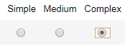
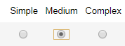
Visualization Capabilities
Client | Data Sources & Processing | Data Visualization | Implementation Style | Dashboard Demo
Global Beverage Leader | 15 distinct data sources . 60+ ETL jobs performed on a weekly basis | Customized by Geography across Supply chain, HR, Marketing & Media Analytics | Built on Tableau v10.2. Customized by Geography across Supply chain, HR, Marketing & Digital teams | Demand GKPI SOM FD
American Major Retailer | 50+ ETL jobs from Google Analytics, Teradata, Omniture & Unstructured digital partner sources | Dashboards for operations Heat maps, Pivot tables, user input accepted | Built on Tableau v10.3 integrated with VB.NET Web app on Azure | Assortment CAT
Global Music Giant | 35+ ETL sources from different finance databases maintained | 15 C-Level dashboards to CFO & CEO reporting on Global Financial position | Built on Tableau v10, Navigate through geographies using links in the visual data points | CFO Dashboard
German Luxury Auto | Evaluating various Business Hypothesis involving Driving styles & Warranty Claims using car sensor data & claims data | Visualize correlation between driving style and warranty claims based on defect instances | Visualized through Tableau v10.3 and also Databricks platform with Apache Spark on backend | DrivingPattern Hypothesis
Large Appliance Manufacturer | Unstructured review data scraped from public domain and ecommerce | SKU, Brand and Category level comparison of features & purchase drivers | Built on Tableau v10.1 with an internal version on client hosted SAS VA server | Voice of consumer
Notes:
Pandora – Demand Forecasting

Slide 112
Thank you

